Slide 1
Advanced Normalization Tools (ANTs) Preprocessing
Elliot Layden
9/13/17

Slide 2
What is ANTs?
An open-source, command-line toolkit consisting of Bash scripts/functions and C++ applications, used for deformable normalization, template construction, tissue segmentation, and a variety of other neuroimaging applications
Relies on functionalities of the Insight Toolkit (ITK; https://itk.org/itkindex.html)
Developed at the UPENN Image Computing & Science Lab (http://picsl.upenn.edu/software/ants/)
ANTs homepage: http://stnava.github.io/ANTs/
Github: https://github.com/ANTsX/ANTs
Help & Discussion Form: https://sourceforge.net/p/advants/discussion/
Avants, B. B., Tustison, N., & Song, G. (2009). Advanced normalization tools (ANTS). Insight j, 2, 1-35.

Slide 3
Why use ANTs?
The ANTs Symmetric Normalization algorithm (SyN; Avants, Epstein, Grossman, & Gee, 2008) performs at the top of 14 competitor deformable normalization algorithms (Klein et al., 2009)
Also provides state of the art methods for…
Intensity inhomogeneity/bias correction (N4ITK; Tustison et al., 2010)
Template building with symmetric group-wise normalization (SyGN; Avants et al., 2010)
Tissue segmentation (Atropos algorithm; Avants, Tustison, Wu, Cook, & Gee, 2011)
Motion Correction (antsMotionCorr.exe)
Cortical thickness estimation (antsCorticalThickness.sh; Tustison et al., 2014)
Avants, B. B., Epstein, C. L., Grossman, M., & Gee, J. C. (2008). Symmetric diffeomorphic image registration with cross-correlation: evaluating automated labeling of elderly and neurodegenerative brain. Medical image analysis, 12(1), 26-41.
Avants, B. B., Tustison, N. J., Wu, J., Cook, P. A., & Gee, J. C. (2011). An open source multivariate framework for n-tissue segmentation with evaluation on public data. Neuroinformatics, 9(4), 381-400.
Avants, B. B., Yushkevich, P., Pluta, J., Minkoff, D., Korczykowski, M., Detre, J., & Gee, J. C. (2010). The optimal template effect in hippocampus studies of diseased populations. Neuroimage, 49(3), 2457-2466.
Klein, A., Andersson, J., Ardekani, B. A., Ashburner, J., Avants, B., Chiang, M. C., ... & Song, J. H. (2009). Evaluation of 14 nonlinear deformation algorithms applied to human brain MRI registration. Neuroimage, 46(3), 786-802.
Tustison, N. J., Avants, B. B., Cook, P. A., Zheng, Y., Egan, A., Yushkevich, P. A., & Gee, J. C. (2010). N4ITK: improved N3 bias correction. IEEE transactions on medical imaging, 29(6), 1310-1320.
Tustison, N. J., Cook, P. A., Klein, A., Song, G., Das, S. R., Duda, J. T., ... & Avants, B. B. (2014). Large-scale evaluation of ANTs and FreeSurfer cortical thickness measurements. Neuroimage, 99, 166-179.

Slide 4
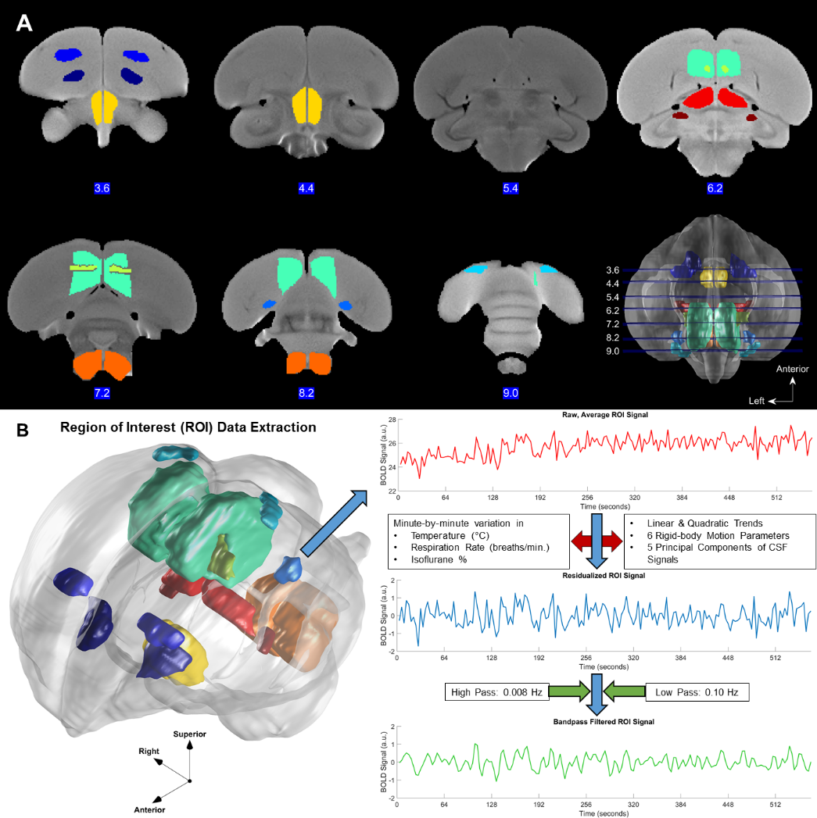

Slide 5
When not to use ANTs
Not advisable to attempt to use ANTs on a Windows system
The precompiled versions available on SourceForge are not kept up-to-date: https://sourceforge.net/projects/advants/
ANTs is very difficult to compile correctly from source code on Windows (presumably much less so on Unix operating systems)
Instead, it is best to use ANTs on either a Unix system or on Midway

Slide 6
Pre-made ANTs Preprocessing Pipeline
Outline:
4D functionals and anatomicals are both bias corrected using N4ITK (Tustison et al., 2010)
Functionals are motion corrected using antsMotionCorr.exe
Coregister average motion-corrected functional and anatomical (affine)
Create group-wise custom brain template (SyNG), initialized to MNI ICBM 2009a Nonlinear Asymmetric 1 mm³ template
Perform a second nonlinear registration of the resulting group-wise template to the MNI ICBM (SyN)
Apply resulting transformations (5 & 6) to anatomicals in a single step, minimizing interpolations: 1. affine to group-wise, 2. non-linear to group-wise, 3. affine group-wise to MNI, 4. non-linear group-wise to MNI
Apply resulting transformations (2, 3, 5, & 6) to functionals in single step:
1. Motion correction, 2. Coregistration affine, -> same as for anatomicals -> final downsampling affine to original functional resolution
8. Anatomical tissue segmentation if desired (Atropos)

Slide 7
Bias Correction (N4ITK)
A bias field, or spatial variation in image intensity not of physiological origin, can result from a variety of sources (Hou, 2006):
Radio-frequency nonuniformity
Static magnetic field inhomogeneity
Head motion
Can be a major problem for tissue segmentation, which relies on distributions of voxel intensities that correspond to a set of tissue classes
N4ITK models inhomogeneity as a low-frequency, smooth bias field via a set of B-spline functions
Hou, Z. (2006). A review on MR image intensity inhomogeneity correction. International Journal of Biomedical Imaging, 2006.

Slide 8
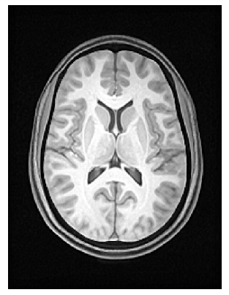
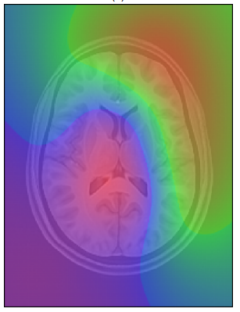
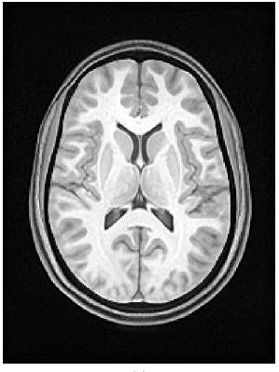
Bias Correction
Tustison, N. (2009). Nick’s N3 ITK Implementation For MRI Bias Field Correction.

Slide 9
Motion Correction
Iterative affine¹ or rigid-body registration of each 3D functional volume to the mean functional volume (averaged across time)
30 iterations with a half-resolution image, then another 15 with full resolution (this can be customized any way desired)
Can output 6 rigid-body motion parameters via a custom Matlab script that converts them from the ITK-style affine matrix
Can also output a 4D image of voxel-wise displacement time series
i.e., rotational head motion will displace voxels to a greater degree the further they are from the center of rotation, so correcting all voxels based on the 6 rigid-body parameters is not likely to be wholly accurate
¹ Discuss advantages/disadvantages to using affine (allows shearing motion) vs. rigid-body (allows only rotations and translation) – ANTs fMRI preprocessing example uses affine (https://stnava.github.io/fMRIANTs/)

Slide 10
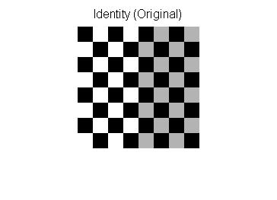
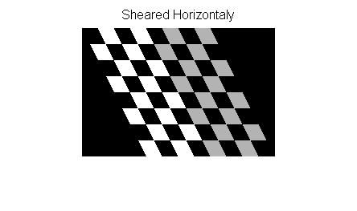
Shearing Motion

Slide 11
Symmetric Group-wise Normalization (SyGN)
Symmetric means that the results of image registration will be identical whether an A -> B or B -> A registration direction is specified
i.e., similarity measure S is the same for a transform T, whether comparing S(TA, B) or S(A, T⁻¹B)
This is not necessarily the case unless the optimization is constrained to take account of both directions (Rogelj & Kovačič, 2006)
Rogelj, P., & Kovačič, S. (2006). Symmetric image registration. Medical image analysis, 10(3), 484-493.

Slide 12
Symmetric Group-wise Normalization (SyGN)
SyGN can use an a priori template (e.g., MNI) as a starting point to warp all anatomicals to, or can use the average of all anatomicals after rigid-body registration as a starting point
Then iteratively warps each anatomical to the template, updating the template also as registration improves

Slide 13
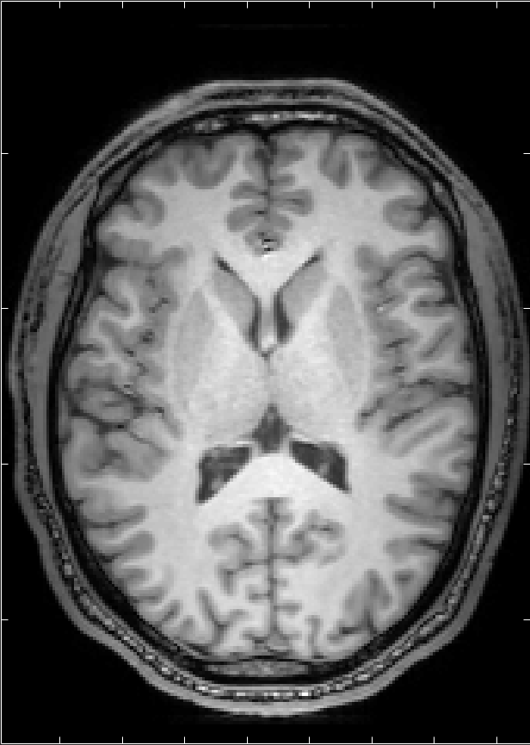
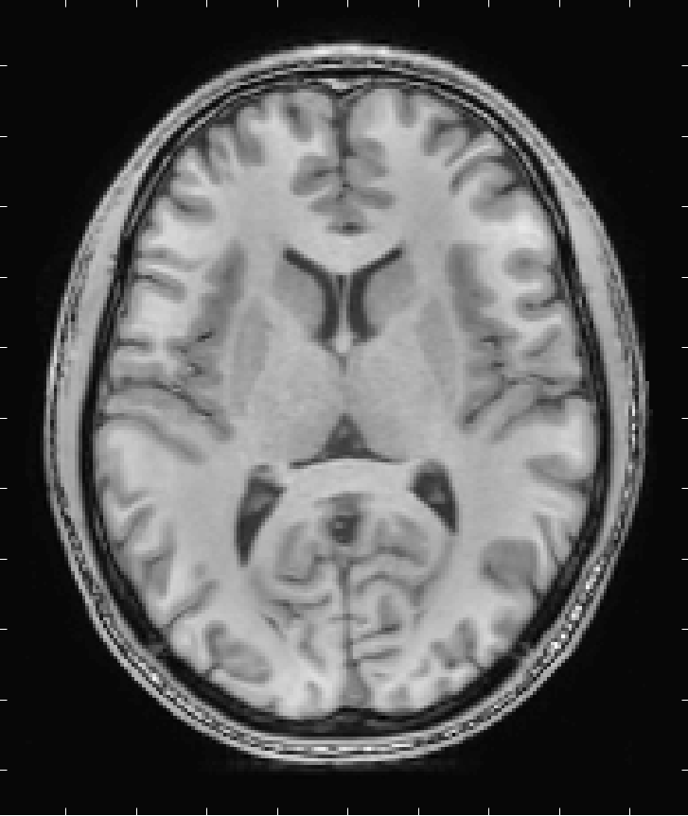
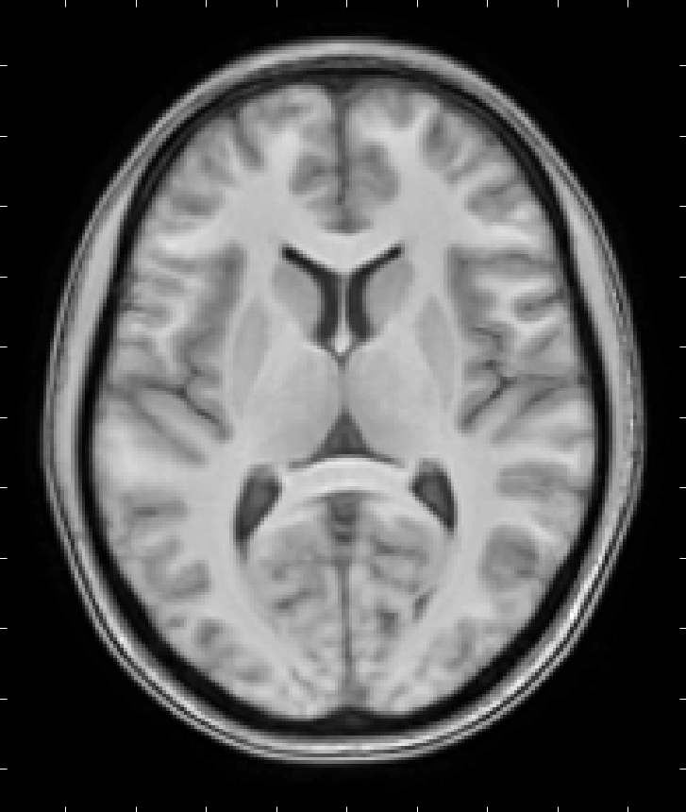
Raw Anatomical
Normalized Anatomical
Group-wise Template

Slide 14
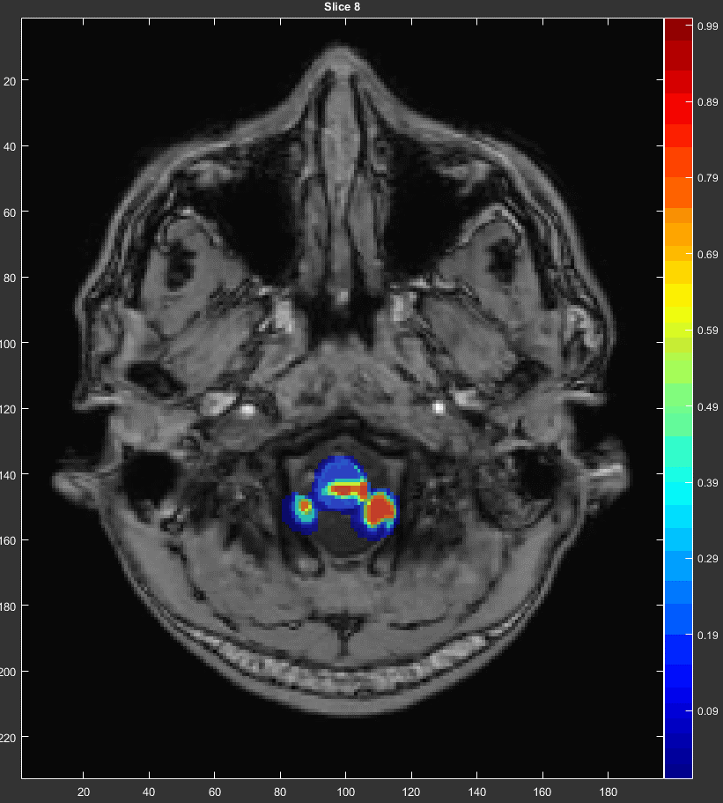
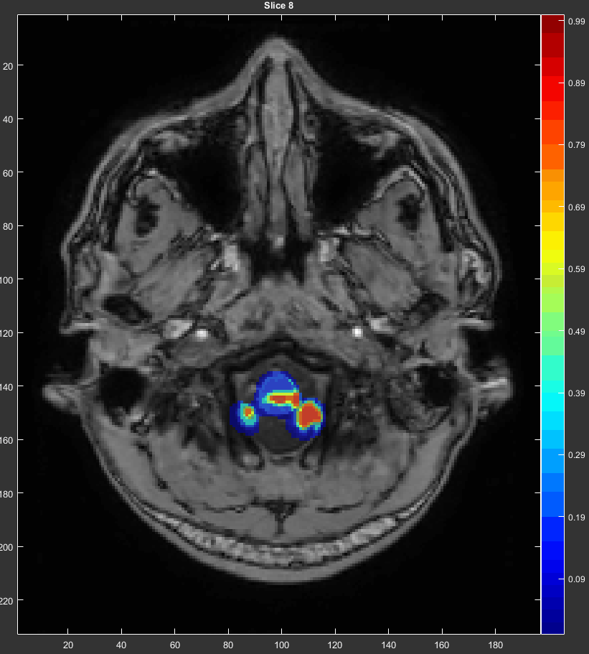
Tissue Segmentation
Distributions of voxel intensity values correspond to different tissue classes
Shown here is voxel-wise probability of Grey Matter for the same normalized anatomical shown in the previous slide

Slide 15
Pre-made ANTs Preprocessing Pipeline
Implementation Outline:
A Matlab script is used to organize neuroimaging files into approximate correspondence with the Brain Imaging Data Structure (BIDS) format
organize4ants_automated.m
2. The resulting analysis folder is uploaded to Midway (e.g., using WinSCP)
3. A Midway sbatch script submits a Bash script to the cluster using the requested resources
ants_preprocessing_midway1.sbatch
The Bash script handles all ANTs commands, requiring no user-specifications, although allowing for customization if desired
ants_preprocessing.sh

Slide 16
Demo
Show Pipeline Instructions help file, and readme help files
Demo organize_neuroimaging_files_point_click.m & organize_neuroimaging_files_automated.m
Demo upload and start processing on Midway

